Slide 1
528 Database Security
October 28, 2015

Slide 2
Big Data Security – HealthCare
Presentation (PPT):
Introduction
Rise of Big Data in Health Care
Case studies (Anthem, Cignet, Premera Blue Cross, PMI)
Products for various kind of database in market
Intro to Hadoop and it’s architecture
Securing data in Hadoop – very brief

Slide 3
Introduction
Impact of government policies on technology and vice versa.
HITECH - The Health Information Technology for Economic and Clinical Health of 2009.
Big Data – Lots of unstructured information.
Business Intelligence – Storing historical data from disparate sources into a data warehouse. Reporting on the data warehouse to answer business queries.
A revolutionary movement as large amount of data in last decade to answer your queries.
Health care expenses represent 17.6% of GDP
Doctors will use this in future for evidence based decision making process.
Rise of “Internet of things” means more data in future – 26million devices in 2020

Slide 4
Case study
Anthem Inc
Hack continued for over a month.
Hackers had access to Anthems database for more than month
DBA discovered this suspicious activity – A query running for a long time.
Data such as SSN was unencrypted.
Breach affected more than 80 million customers.
During this situation Anthem put up posts to hire Cloud security professionals.
Anthem was fined $1.7 million for breach.

Slide 5
Case study
Premera Blue Cross
Premera Blue Cross in Washington state and Alaska – Victim of “sophisticated cyber attack”.
Stolen information included data on members from other plans who received care in Washington and Alaska.
Suspected that personal information from as early as 2002 must have been stolen.
Cignet Health Center
Non compliance with HIPAA policies are also causes of penalties.
A case of non-compliance occurred at Cignet Health Center, which is essentially a group of clinics that denied turning in the medical records requested by the patients.
Fine of $4.3 million

Slide 6
Future – Precision Medicine Initiative
A bold new research effort to revolutionize how we improve health and treat disease.
An innovative approach that takes into account individual differences in people’s genes, environments, and lifestyles.
A database of genetic, dietary, health history, lifestyle and other such data from over a million Americans.
This warehouse will be more than any other health care setting.
To secure this data experts from domains such as Health IT, ethics, data science, security have come together and are brainstorming.
The implementation will be put to penetration testing and auditing at regular intervals.
One of the challenge is that design should be easily implemented and secure both at same time.

Slide 7
Some types of databases
Architects want to secure the network layer, end point layer, the interfaces to the system which act as port of entry and exits.
At the heart of all this lays the database. An architect wants to chose a secure database without compromising it’s performance.
Based on the kind of data advanced databases are available.
A major challenge – None of them have inherent features to completely secure the database.
Neither are there vendors who guarantee a completely secure system. They might only offer maximum security.
Example of vendor products :-
Imprivata single sign on (Access and privileges)
Identity Finder (Monitoring PHI footprint – Risk arises from authorized users.. )
BrightPoint security (Threat Intelligence)
VASCO (Authentication – EPCS compliance)
Many more products.

Slide 8
Advanced Databases
Wide Column Store/Column Families
Considered as a clone of the Google’s “Big Table” - proprietary technology by Google on top of its other technologies such as Map-Reduce, GFS (Google file system), Chubby file locking, SSTable.
Single associative array – Horizontal scaling
Maps a row value to its corresponding key value and then attaches the timestamp to it and stores this in the associative array.
Compute and storage - scales into the Petabyte range across hundreds or thousands of servers with the ability to easily add servers to scale resources.
Data is stored column wise rather than row wise.
There are several products providing column-oriented databases or data stores:
BigTable
Aster Data
SAP HANA
Cassandra
Hyper Table

Slide 9
Advanced Databases
2. Document Store
Doesn’t mean that it stores documents like pdf.
Contains data with some metadata.
Data is stored in an xml format wherein each tag of the xml document tells us about the data within the tags.
Supports both large/small reads – Stream or block transfers
Examples of Document Stores for Big Data include:
MongoDB
CouchDB
TerraStore
3. Key-Value / Tuple storage
Idea here is to avoid duplicates in the database so as to achieve higher performance
Analogous to hash table.
Also known as tuple stores and are very popular in BigData world.
Binary objects such as BLOB can also be stored against a key.
Drawback - user needs to write a code defining the data being stored
Examples of key-value databases that are used in Big Data are:
BigTable
Couchbase Server
Berkeley DB
Amazon Dynamo DB
Dynomite

Slide 10
Advanced Databases
4. Graph Databases
Builds relations between the data sets at first and then stores the data.
Uses various objects of a graph – nodes, edges and properties.
Start from a node and go along the edge to reach another node.
Nodes contain information you want to keep track of, and the properties are pertinent information that relates to the node.
Edges are lines that connect nodes to nodes or nodes to properties, and they represent the relationship between the two.
Gaining popularity in Big Data because they can be used to gain more information (insight) into the data because of the edges.
Examples of graph databases are:
InfoGrid
HyperGraphDB (Uses Berkeley DB for data storage)
Allegro Graph
Hadoop

Slide 11
Advanced Databases
5. Multi model databases
This class of database can provide multiple techniques. Example a database could be a document store and a graph database both.
Examples of these databases are:
AllegroGraph
Hadoop
Virtuoso
6. Object Databases
Implements the object oriented concepts to store the data.
It is combination of database with objects where objects are used in object oriented programming.
Therefore the database here appears tightly coupled.
Examples of Object databases for Big Data are the following:
Versant
DB40

Slide 12
Cloud Environment
Constant inflow of data puts a burden on the data centers which are mostly cloud based.
Data contains varying categories of information such as patient history, social information, dietary history, genetic transitions etc.
Each of this data might be in different database depending on its structure. The aforementioned databases can be some of the candidates.
This makes the massive distributed cloud highly complex, and this complexity is directly proportional to time.
The whole architecture with its varying set of technologies acts as SaaS (software as a service).

Slide 13
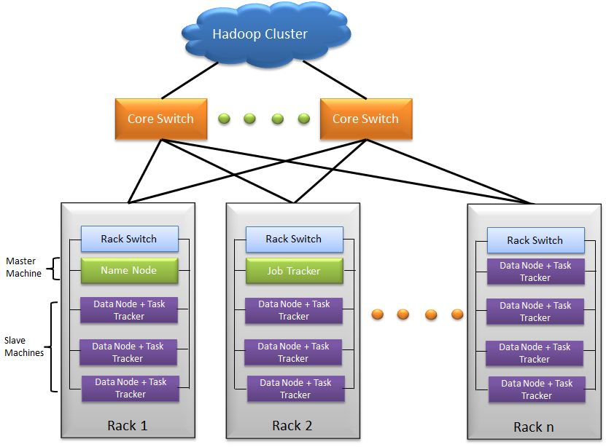
Hadoop - Overview
Hadoop is a free, Java-based programming framework that supports the processing of large data sets in a distributed computing environment.
A number of tools mentioned in the second section have connections to use Hadoop as a storage platform.
There are two important components of Hadoop : -
HDFS
MapReduce
Hadoop has its own file transfer protocol which transfers in blocks. Not Ethernet or TCP/IP which transfer in packets.
This makes the massive distributed cloud highly complex, and this complexity is directly proportional to time.

Slide 14
Hadoop – Architecture Diagram
A node - is a computer, non enterprise commodity hardware - contains data
A rack - a collection of 30-40 nodes - connected to same switch
N/w bandwith between two nodes on same rack > n/w bandwidth between nodes on diff racks
Works best with large file - streaming data access patterns - Minimizes seeks due to large files - BEginning of block and read sequentially from there.
Blocks of data - 64(default)/128mb. Blocks are replicated across multiple nodes.
Cluster
Rack 1
Rack 2
Rack n
Data Node 1 +
Task tracker
Data Node 1 +
Task tracker
Data Node 1 +
Task tracker
Data Node 2 +
Task tracker
Data Node 2 +
Task tracker
Data Node 2 +
Task tracker
Data Node n +
Task tracker
Data Node n +
Task tracker
Data Node n +
Task tracker

Slide 15
Hadoop – Architecture Diagram
NameNode
One per cluster. It manager the filesystem metaspace and metadata.
Large memory requirements as it stores the whole file system metadata.
Maintain copies of NameNode.
DataNode
Contains blocks of data. Periodically reports to name node what it contains (metadata).
PCIe SSD can be used for storage. These provide fast transfers with 10 channels.
Job Tracker
Manages Map/Reduce tasks on the task tracker. Monitors these tasks.
Task Tracker
To achieve parallelism. Each Task tracker is a JVM running a Map/Reduce task.
DataNode
Task Tracker
DataNode
Client
Job Tracker
NameNode
DataNode
Task Tracker
DataNode

Slide 16
Conclusion
From the case studies discussed earlier it is clear that hacks have occurred at various levels of information such as files or records in database.
Therefore we need strategies to secure data at both coarse grained (volume/file) and fine grained (field/column) level.
Techniques for database security such as tokenization, masking, encryption, monitoring should be applied simultaneously on both these levels.
High degree of parallelism in modern databases can be leveraged to achieve faster encryption and decryption while transferring data between nodes.
The kind of protection should be in compliance with the HIPAA and HITECH policies.
If the architecture is such that each of its node is completely secure then the whole system would eventually prove to be secure.
QUESTIONS ???

